Slide 1

Section 3: UML Modelling
Software Design Workshop Series

Slide 2
Unified Modeling Language (UML) is a standard way to visualise software design.
Helps communicate structure and behavior of systems.
Used throughout the software development lifecycle.
What is UML?

Slide 3
Show interactions between users (actors) and the system.
Highlight system functionality from the user's perspective.
Elements: actors, use cases, system boundary, relationships.
Use Case Diagrams

Slide 4
UML standards has 13 different types of diagrams:
UML diagrams
Class
Activity
Object
Use case
Sequence
Package,
State
Component
Communication
Composite structure
Interaction overview
Timing
Deployment
In this section we will explore three of the diagram

Slide 5
Use Case Example
User logs in to the system.
User browses available products.
User places an order.
Admin manages user accounts.

Slide 6
Sequence Diagrams
Show how objects interact in a particular scenario.
Focus on the order of messages between objects.
Useful for visualizing workflows and method calls.
User WebApp Database
| | |
|----- Login Req -----> | |
| |--- Query User ------> |
| |<--- User Record ----- |
|<--- Auth Result ---- | |
| | |
|----- View Data ----> | |
| |--- Fetch Data -------> |
| |<--- Data Result ------ |
|<-- Display Data- | |
| | |

Slide 7
Aligning UML with User Stories
Use case diagrams reflect user goals and interactions.
Class diagrams model data from user stories.
Sequence diagrams show how features are implemented.
UML diagrams help validate requirements and design consistency.

Slide 8
What Is a Use Case diagram?
Aligning UML with User Stories
Use case diagrams reflect user goals and interactions.
Class diagrams model data from user stories.
Sequence diagrams show how features are implemented.
Helps validate requirements and design consistency.

Slide 9
Key Elements
Aligning UML with User Stories
Use Case
Actors
Use Cases
Relationships
External users or systems Examples: Customer, Admin, Payment Service
Actions or goals Examples: Place Order, Register Account
Include → shared behaviour
Extend → optional behaviour
Generalisation → inheritance
Checkout
<<include>>
Process Payment
<<extends>>
Print Receipt

Slide 10
Example: Online Shopping
Add to Cart
<<include>>
Browse Items
Register
Make payment
Write review
Login
Guest
<<extends>>
Checkout

Slide 11
Why Use Case Diagrams Matter
Clarify functional requirements early
Provide shared understanding
Identify missing or duplicate functionality
Foundation for:
User stories
System design
Test cases

Slide 12
UML Class Diagram
Let's learn about UML class diagram to describe your design
Show Interfaces, Inheritance and Polymorphism
Aggregation
Association Qualifiers

Slide 13
Class Diagrams
Represent the static structure of a system.
Show classes, attributes, methods, and relationships.
Useful for designing data models and backend structure.

Slide 14
Relationship between classes
Association Basic relationship between classes.
Aggregation whole-part relationship (weak ownership).
Composition strong ownership, Part cannot exist without whole.
Inheritance one class inherits from another.
Relationships

Slide 15
Why Build UML Class Models?
Cheaper than building the real thing
To provide a clear abstraction of concepts
To gain understanding, before building
To provide a common vision for users and developers
To manage, scope and document complexity
Notes:
Why do we build models? Simply because they are cheaper than building the real thing.
Models have been built in many industries in order to ensure the success of the final product. Builders of aeroplanes model the aerodynamic behaviour of planes before committing to construction. Architects draw blueprints of floor layouts, and build scale models of houses, shops and office buildings before the construction crew start implementing the reality in bricks and mortar. UML’s view of a model is based on that of OMT; it is an abstraction of something for the purpose of understanding it before building it.
Models are essential firstly for customer communication and secondly for team understanding. Having a common reference of what is being described helps in most aspects of development, but it is particularly important in system development, where we are often creating things that have no physical comparison. Having a common language to communicate and criticise ideas is probably the most important aspect of a development method. The visualisation of what a system may do, before years of code have been developed, can substantially increase the quality of systems and code.
The human mind can only deal with a small number of concepts at once, then quickly forgets the decisions and ideas developed. Managing, scoping and documenting complexity is a primary goal. Most systems being developed today are too complex to understand directly. UML models reduce complexity by separating out a small number of important things to deal with at a time. This is done using a range of models and development phases, where the attention can be focused on the important issues at that point in the development.

Slide 16

UML Class Association
Association example: Customer has a reference to Account
class Customer
{
Account account;
public Customer()
{
account = new Account();
}
}

Slide 17

Dependency - looser association
class Bank
{
public void Register(Account acc)
{
acc.Open();
}
}
Passed as a parameter and used only by this method

Slide 18
UML Dependency - another example
class Bank
{
public void CreateAccount(int id)
{
Account account = new Account(id);
accounts.Add(account);
}
}
Created and used within the method
The object only persists within the method

Slide 19
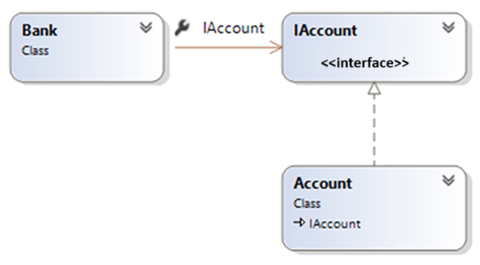
Dependency – reducing hard coupling
class Bank
{
public void Register(IAccount acc)
{
acc.Open();
}
}
A kind of account is passed in and used only within the method

Slide 20
Interface Notation in UML
<<interface>>
Taxable
GetTax()
Employee
Taxable
dotted
The correct term for this is "to realize" an interface
GetTax()
Employee
GetTax()
Would you say: An Employee is a kind of taxable (item) ?
Or does it sound better to say: An Employee supports all Taxable Operations?
Notes:
Interfaces can be replaced graphically by a named circle. The definition of the interface is defined elsewhere, either graphically or in the repository of a CASE Tool.

Slide 21
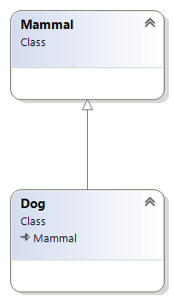
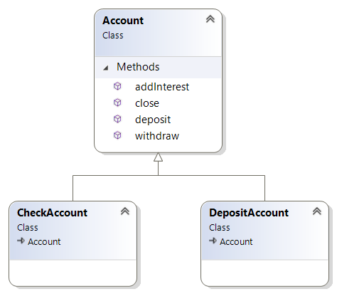
Abstract Base Class
You could view an interface as a degenerate version of an Abstract Base Class
generalisation
specialisation
You can’t create a mammal, or an Account. They are abstract classes
Notes:
There are many concepts that we use in everyday life that certainly never manifest themselves as objects – they are just concepts.

Slide 22
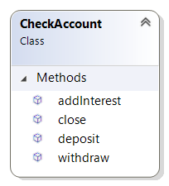
What is the Difference ?
withdraw
Deposit
addInterest
Close
Inheritance Of Interface And
Inheritance Of Implementation
Notes:
To the client there is absolutely no difference. The client has no awareness of how the CheckAccount object may be built.
If the CheckAccount object happens to be built using inheritance, then the author of the CheckAccount just programs by difference.
If the CheckAccount is built using just interface, then the author has to put in the code.

Slide 23

Aggregation
Is a weak form of whole-part relationship. The part can exist independently of the whole.
A BankAccount can exist and operate even when NO Customer refers to it.
*
customer can have zero to many accounts
Use numbers to restrict creating of BankAccounts
1..3

Slide 24
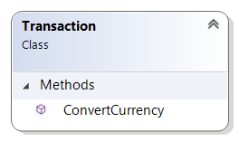
Composition – Delegation of work to other objects
*
1
ConvertCurrency
1..*
The part cannot exist independently of the whole Transactions can't exist without a BankAccount

Slide 25








Aggregation
*
create, archive
0,1
create, wag, droop
*
start, stop, service
*
doTask
Notes:
The diamond is shown next to the class designated as the whole. The other object is the part. There is no need for an association name or role names; the aggregation defines that the whole 'is made up of', or 'contains', or 'has' the parts, and the parts 'are part of', 'are contained by' or 'belong to' the whole.
In an example of a Car to Chassis relationship, there is aggregation, because:
There is a whole-part relationship; the Car is a whole, the chassis part of it.
Chassis’ don't normally exist independently (except in a manufacturing situation).
If the Car is crushed in a junk yard, the Chassis would be crushed too.
To check a chassis number, you would first identify the Car.
If you drive the Car to Glasgow, the Chassis would go as well.
In an example of a Car to Driver relationship, there is not aggregation, because:
There is no whole-part relationship.
Each exists without the other.
Cars and Drivers are created and destroyed independently.
Access to Cars is independent of access to drivers.
Although the Car may be driven to Glasgow, and the Driver would
probably go with it, the Driver could also take the train to Edinburgh.

Slide 26
Quiz
As a group , decide for each of the following whether each aggregation or association would be most appropriate
A track on a CD
A mobile phone has a battery
A portfolio contains assets
A car parked in a car park
An organisation has many departments
A person driving a car
A guitar has strings

Slide 28
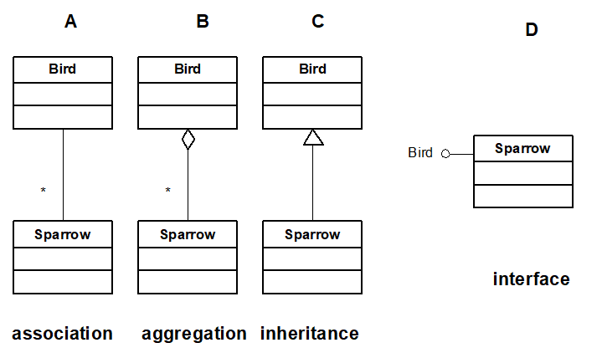
Bird or Sparrow

Slide 31
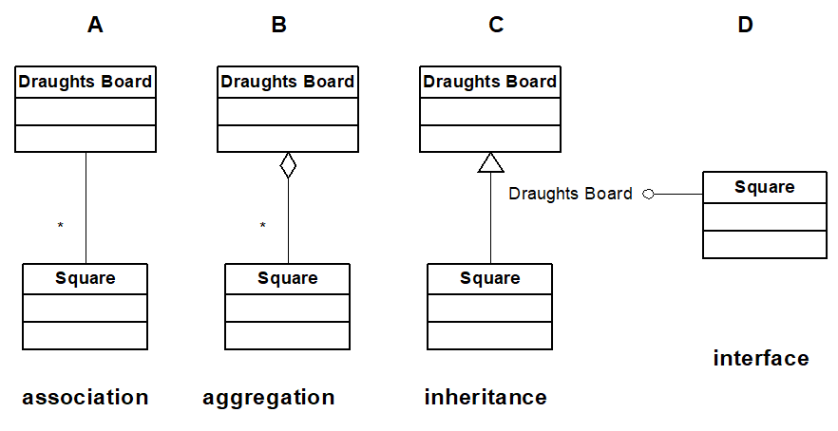
Draughts Board

Slide 32
UML helps visualize system structure and behavior.
Use case diagrams show user interactions.
Class diagrams define data and relationships.
Sequence diagrams illustrate process flows.
UML aligns design with user stories.
Section Summary

Slide 33
Draw a use case diagram for a food delivery app.
1
Create a class diagram for users, orders, and restaurants.
2
Explain how your diagrams relate to user stories.
Lab Task 3

